Slide 1

Awards
Patti Poston
FIRST Senior Mentor, Nevada

Slide 2
2020 Changes
Control Award – moved up
Inspire, Think, Connect, Innovate, Control, Motivate, Design
Team Judging
5 minutes for presentation only – optional
5 minutes minimum for Q&A up to 10
Regional Judge Advisor

Slide 3
2020 Changes, cont.
Judging Feedback
Teams must submit a judging feedback form
Judges will add their feedback
JA send feedback to Lead coach/Mentor 1 after event
Engineering Portfolio
15 pages of teams most relevant work
Engineering notebooks kept at Team Pit

Slide 4
Three Types of Awards
Judged Optional Awards
Compass
Promote
Judges
Machine creativity and Innovation Awards
Innovate
Control
Design
Team Attribute Awards
Connect
Motivate

Slide 5
Compass Award (Optional Video)
Video Requirements
Must follow FIRST branding and design standards
60 seconds or less
High quality
Copyright for music
List permissions in credits
Submitted by the deadline
Video highlights the mentor’s contribution to the team and demonstrates what sets the mentor apart.

Slide 6
Promote Award (Optional Video)
Video Requirements
Must meet branding and design standards
60 seconds or less
High quality
Copyright for music
List permissions in credits
Submitted by the deadline
Strong production value
Thoughtful and impactful video that appeals to public
Creativity with theme

Slide 7
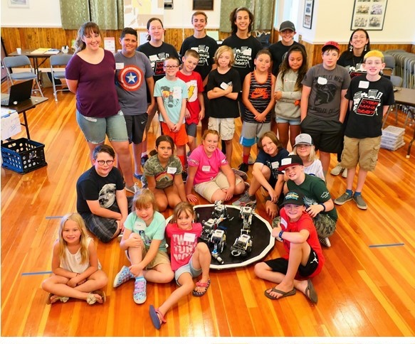
Judges Award (Optional)
Might not be given
Unique efforts, performance, dynamics merit recognition

Slide 8
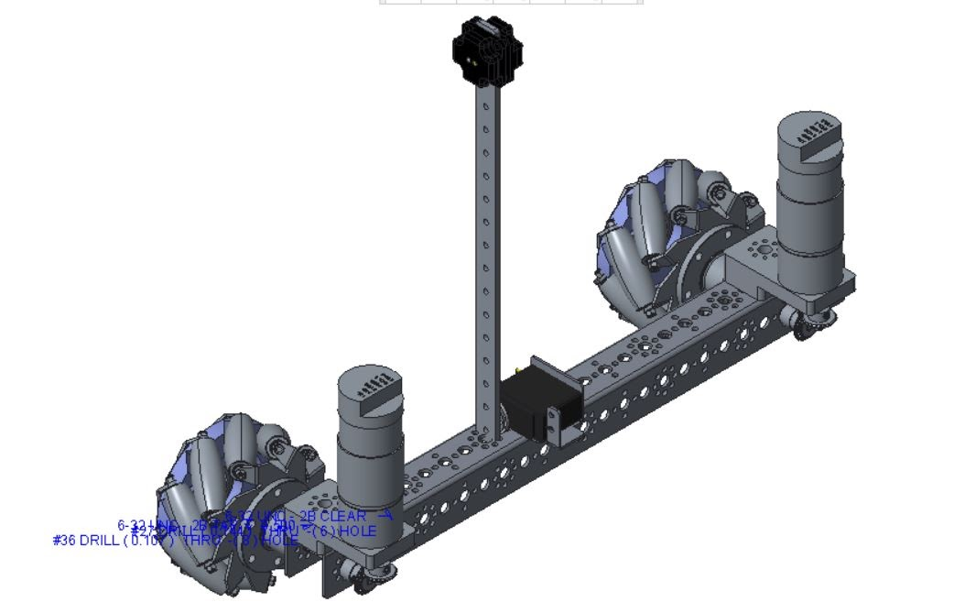
Design Award (Robot)
Requirements
Gracious Professionalism
Engineering Notebook
Robot CAD images
Detailed design drawings
Design principles
Aesthetic and functional design
Basis for design well considered

Slide 9
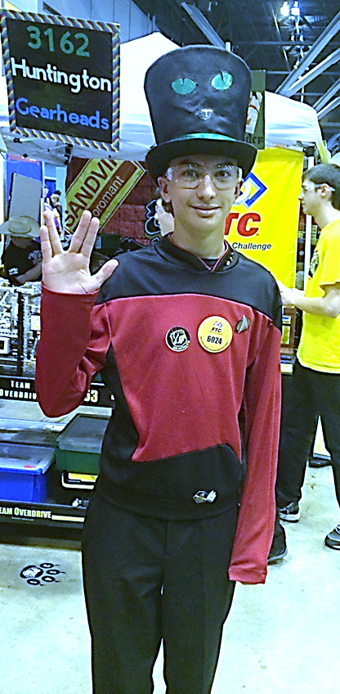
Motivate Award (Community Outreach)
Requirements
Gracious Professionalism
Engineering Notebook
Ambassador for FIRST programs
Successful recruitments
Explain contribution of each team member

Slide 10
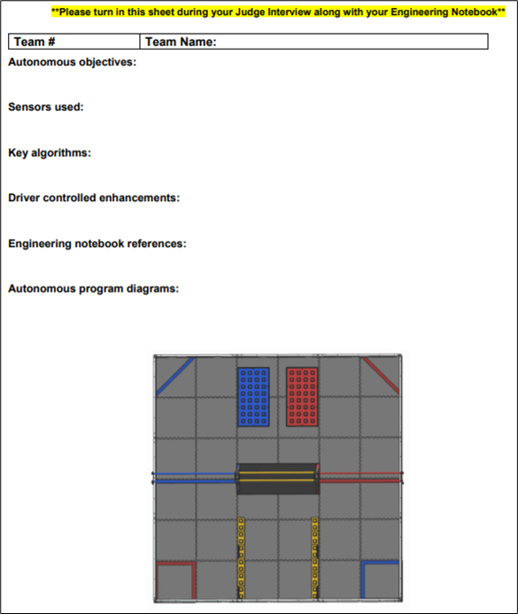
Control Award (Programming)
Sponsored by ARM, Inc.
Requirements
Gracious Professionalism
Control Award Submitted
Engineering Notebook details
Control components must enhance the functionality of the robot on the playing field
Judges at competition looking at your field performance

Slide 11
Innovate (Robot)
Sponsored by Collins Aerospace
Requirements
Gracious Professionalism
Engineering Notebook
Document design process
How they arrived to their design
Robot or robot sub-assembly must be creative, elegant and unique in its design.
Creative component must be stable, robust, and work reliably.
Robot design is effective and consistent with team plan and strategy.

Slide 12
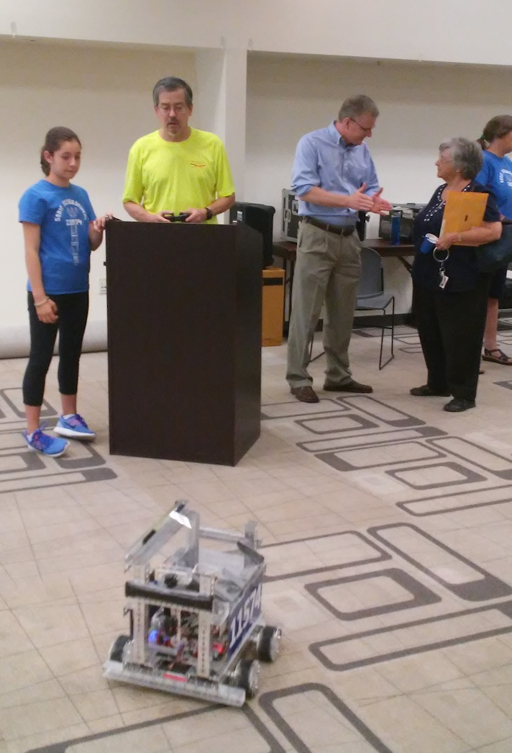
Connect Award (Engineering Outreach)
Requirements
Gracious Professionalism
Engineering Notebook
Team plan
Future goals – steps for goals
Ie. Fundraising, sustainability, timelines, outreaches, community service goals
Shows clear connections with engineering, science, or technology community
Actively engages with engineering community

Slide 13
Think Award (All)
Requirements
Gracious Professionalism
Engineering notebook:
Science
Math
Game Strategies
Clear understanding design process – pictures, drawings
Documenting all stages
Show team’s journey
Organized

Slide 14
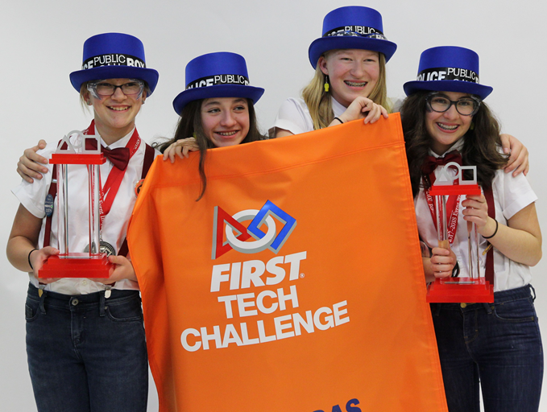
Inspire Award (All)
Requirements
Gracious Professionalism
Strong in all judged awards
Ambassador for FIRST programs
Positive and inclusive
Each team member contributes
Engineering Notebook
Engineering content
Team information
Team plan
Robot design is creative and innovative
Robot performs reliably on field
Team presentation is professional and engaging

Slide 15
Advancement
Inspire Award Winner
Robot game winner Alliance Captain
Inspire 2nd place
Robot game winner 1st Team selected
Inspire 3rd place
Robot game winner 2nd Team selected
Think Award Winner
Robot game 2nd Place Alliance Captain
Connect Award Winner
Innovate Award Winner
Robot game 2nd place 2nd Team selected
Control Award Winner
Motivate Award Winner
Design Award Winner
Robot Game Next Highest Ranked Team
Think 2nd Place
Robot Game Next Highest Ranked Team
Connect 2nd Place
Robot Game Next Highest Ranked Team
Innovate 2nd place

Slide 16
Credits
This lesson was written by Patti Poston
You can contact the author at: pposton@firstinspires.org
More lessons for FIRST Tech Challenge are available at www.FTCtutorials.com
Image Credit: 6024 Enterprisers, 5326 Enterprisers, 11574 Sonic Screwdrivers
This work is licensed under a
Creative Commons Attribution-NonCommercial-ShareAlike 4.0 International License.

